Slide 1
Name: Anshul roll no: 2010990093 Submitted to: Lavish arora

Slide 2
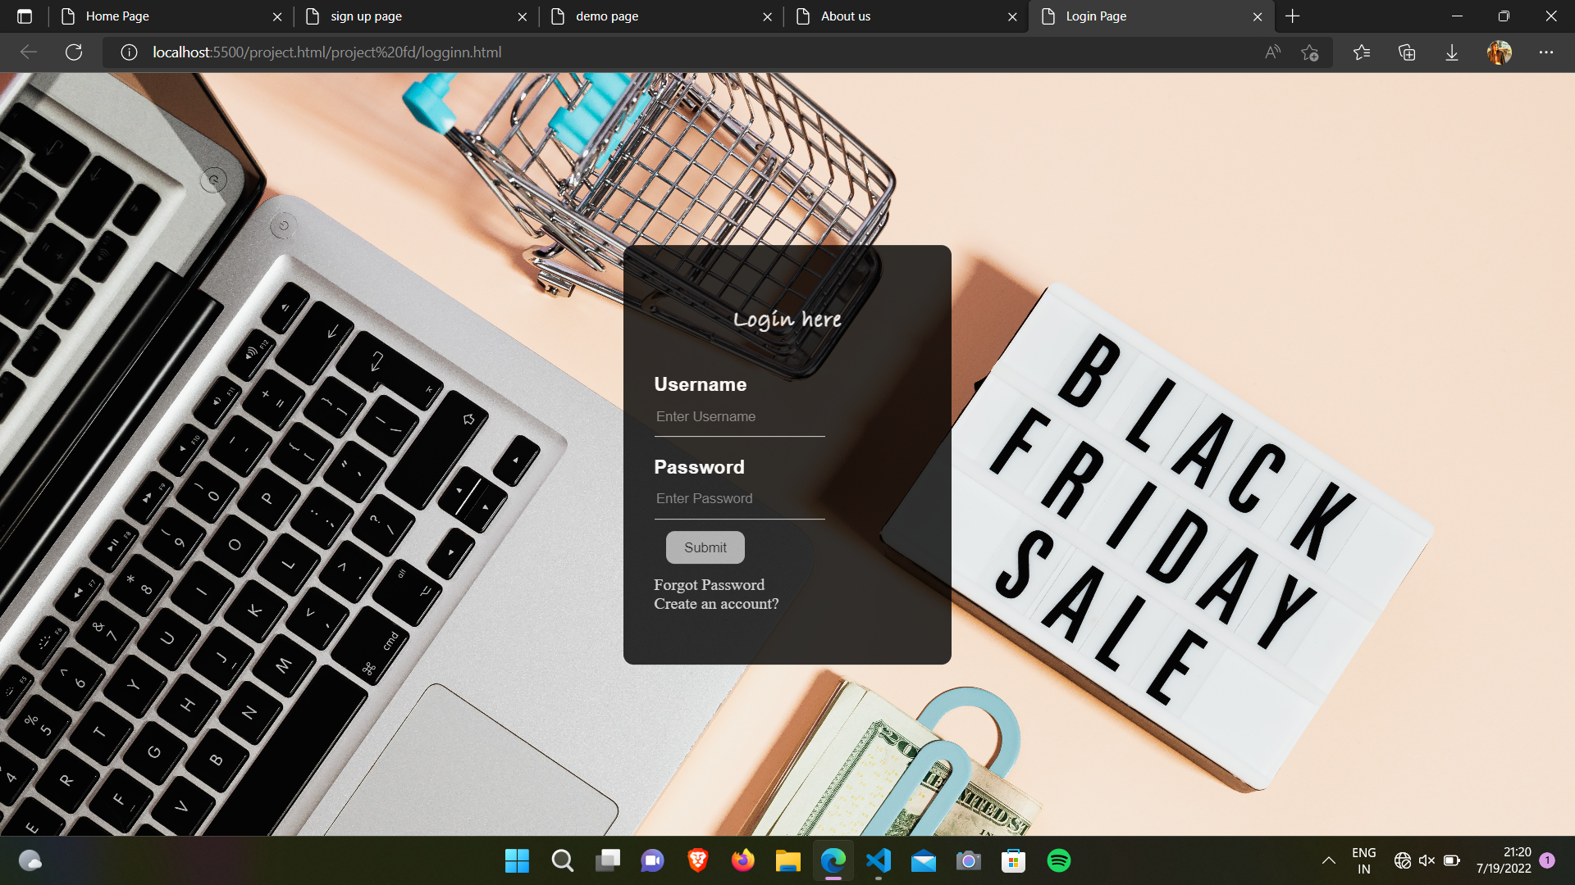
Login page

Slide 3
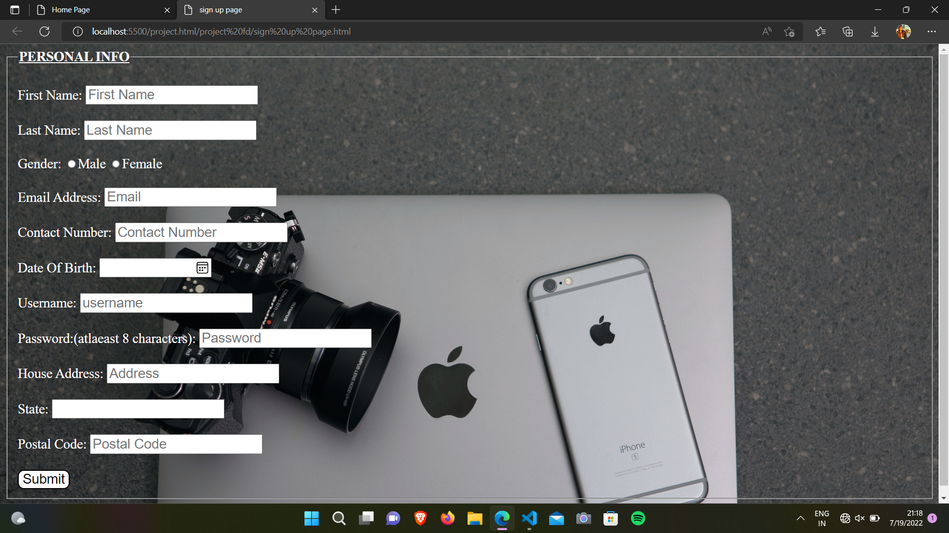
Sign up page

Slide 4
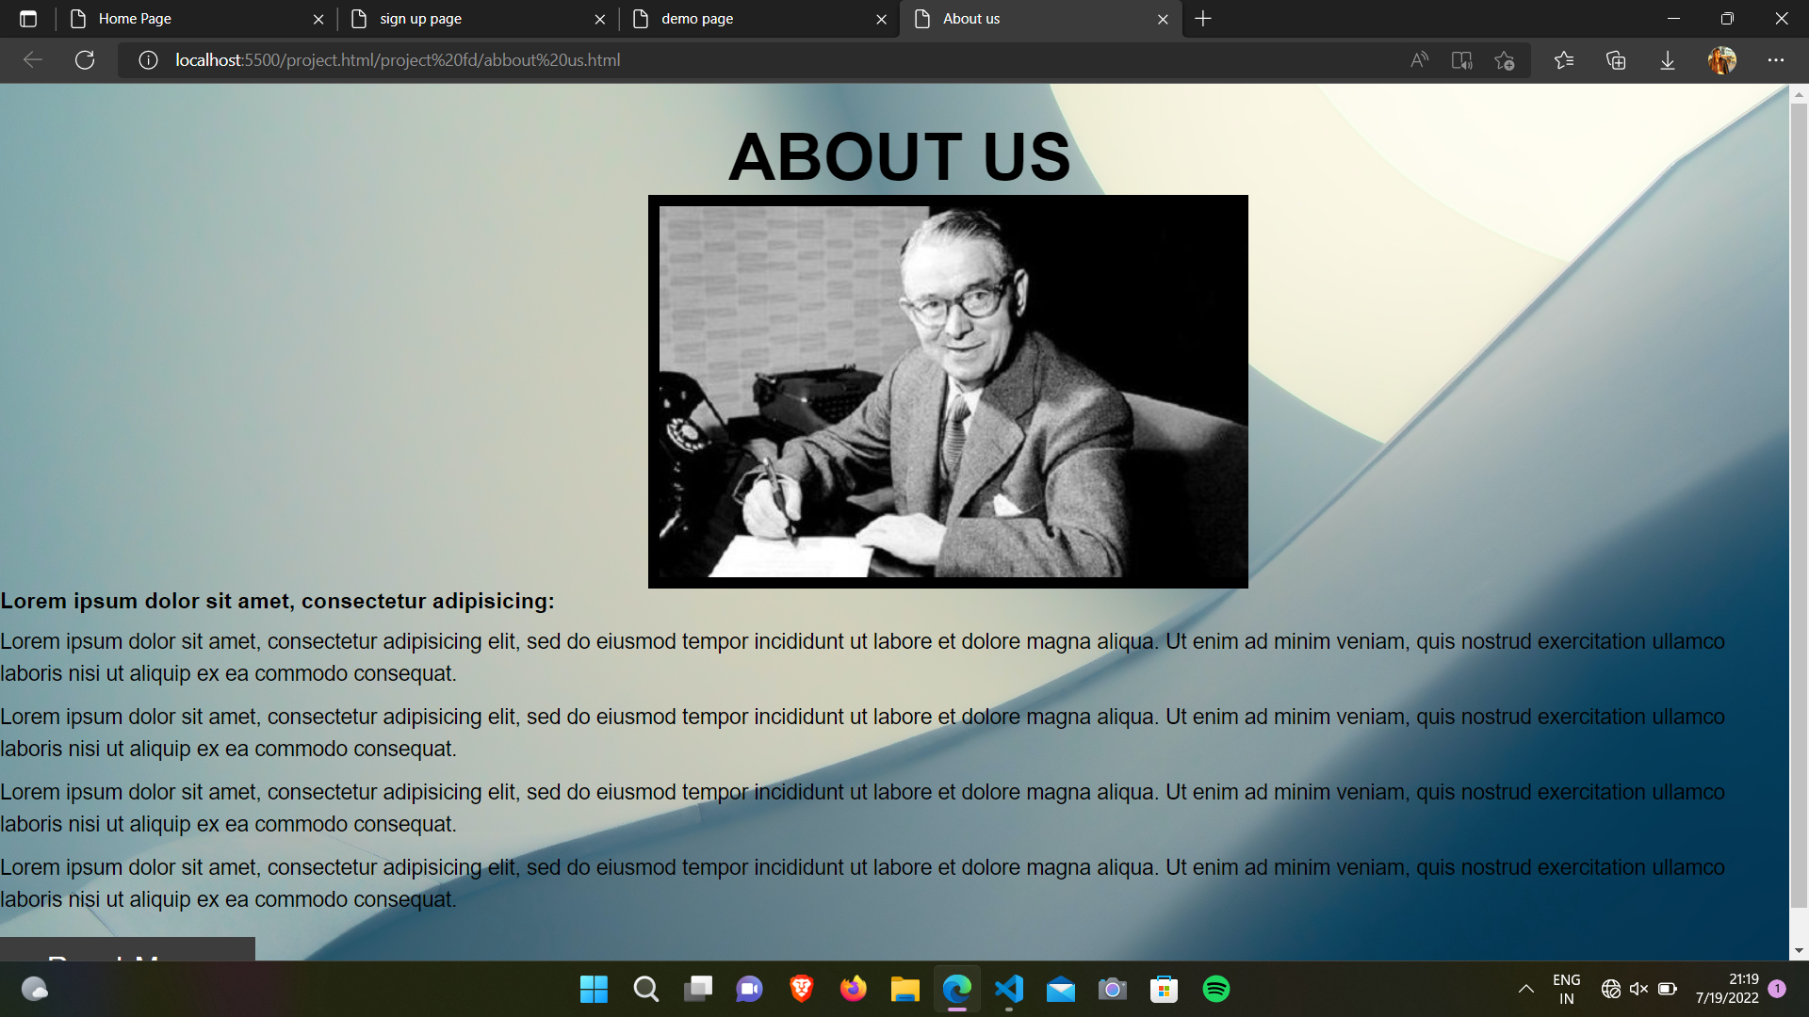
About us page

Slide 5
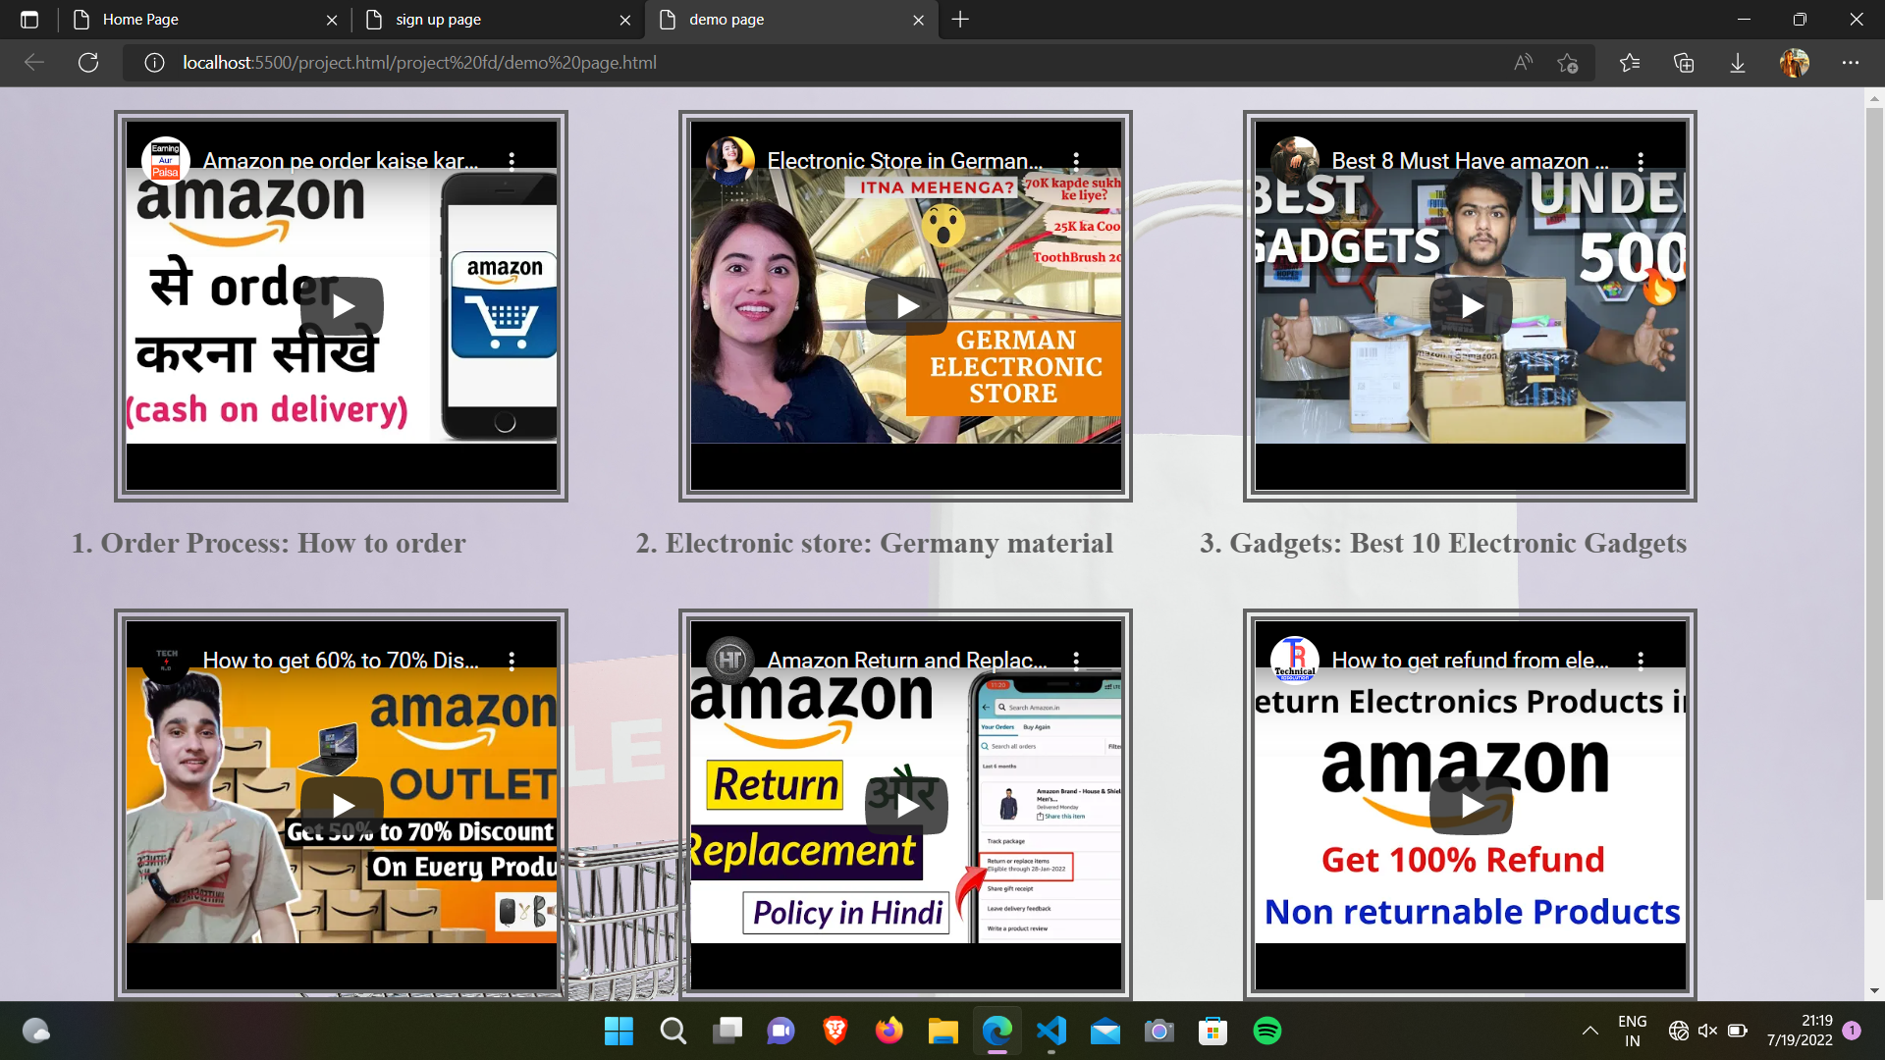
Demo page

Slide 6
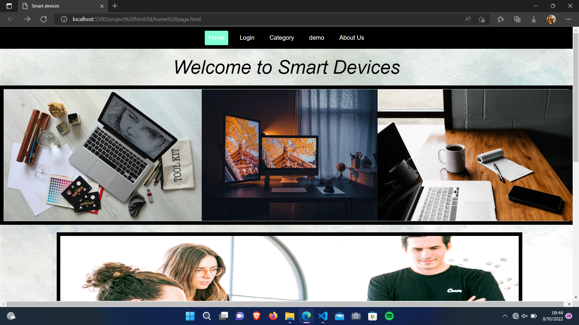
Home page

Slide 7
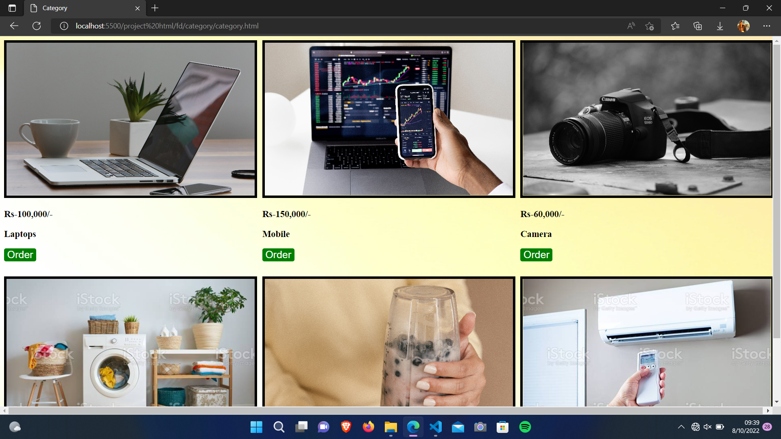
Category page

Slide 8
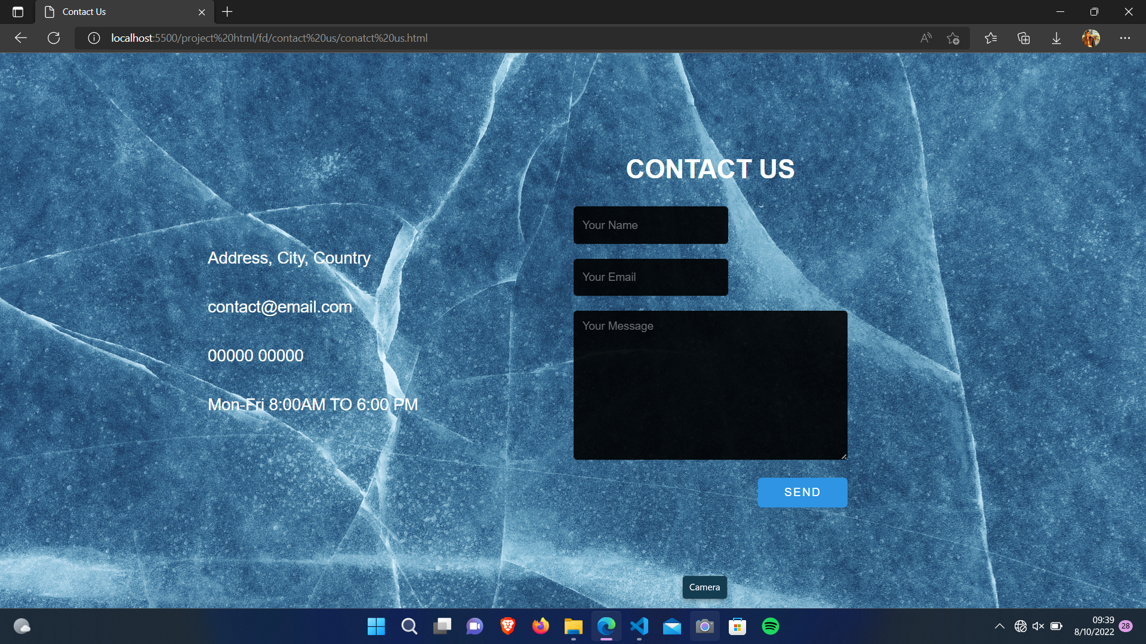
Contact us page

Slide 9
1.HTML
2.CSS
Languages
Used :

Slide 10
Div <div>
Form <form>
Input<input>
Textarea <textarea>
Unordered list <ul>
Button <button>
Anchor <a>
Tags used in HTML

Slide 11
Div tag is used for creating block level elements.
Form tag is used for creating contact us form.
Input tag is used for creating input field of name and email.
Textarea is used for creating a message field.
Unordered list is used for creating list items for skills,achievements and certifications section.
Button tag is used for creating send message button.
Anchor tag is used for creating links for social media icons.

Slide 12
background-image
text-align
text-decoration
float
border-radius
Margin and padding
Hover
Properties used in
CSS

Slide 13
Background image is used for setting background image for different elements.
Text align is used for moving the text in centre.
Text decoration is used to underline the text.
Float property is used for shifting the skills,achievemnts and certifications box in left and right.
Flex property is used in contact us page and divides contact and message container.

Slide 14
Border radius is used for making rounded borders.
Margin is used for setting space around an element’s border and padding is used for setting space between element’s border and content.
Hover property is used in send message button.

Slide 15
THANKYOU…!!

